Slide 1
▤
BIG DATA SECURITY • GROUP 6
Centralized Log
Monitoring System
Collecting, indexing, and visualizing security logs from SSH, web, and application
sources for real-time threat detection
PRESENTED BY
Halima Mohammed • Howard Muchaki • Arlen Ngahu
Notes:
Good morning/afternoon. We are Group 6, and today we'll walk you through our Centralized Log Monitoring System project for Big Data Security.

Slide 2
INTRODUCTION
Project Overview
ℹ
Background
Project Objective
To build a centralized log monitoring system that:
Organizations generate thousands of log records every day from servers, applications, and network devices. These logs hold vital clues about user activity, system performance, and potential security threats.
Monitoring each source individually is inefficient and makes it difficult to detect attacks quickly — the motivation for a single, centralized view.
✓
Collects logs from multiple sources
✓
Detects failed logins & suspicious activity
✓
Stores logs in a central repository
✓
Visualizes activity through live dashboards
Centralized Log Monitoring System | Group 6
Notes:
Our objective was to build a centralized log monitoring system that collects logs from different sources into one platform. Instead of checking logs separately, administrators can monitor everything through one dashboard and quickly identify suspicious activities.

Slide 3
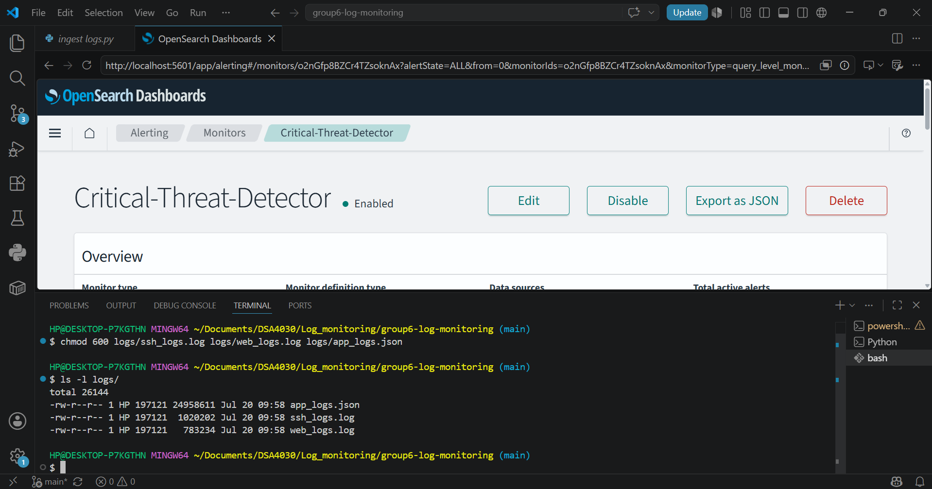
PART A
Environment Setup
1
Data Sources
SSH authentication, web server & application logs
2
Storage Platform
OpenSearch
3
Security Tools
OpenSearch • OpenSearch Dashboards • Python ingestion script
Docker containers running — OpenSearch & OpenSearch Dashboards
4
Deployment
Docker containers
The full stack — OpenSearch, Dashboards, and the ingestion script — runs inside Docker containers, keeping the environment portable and reproducible.
Centralized Log Monitoring System | Group 6
Notes:
We used Docker to deploy the entire environment. Logs were generated from SSH, web server, and application sources. OpenSearch was used to store and index the logs, while OpenSearch Dashboards allowed visualization.

Slide 4
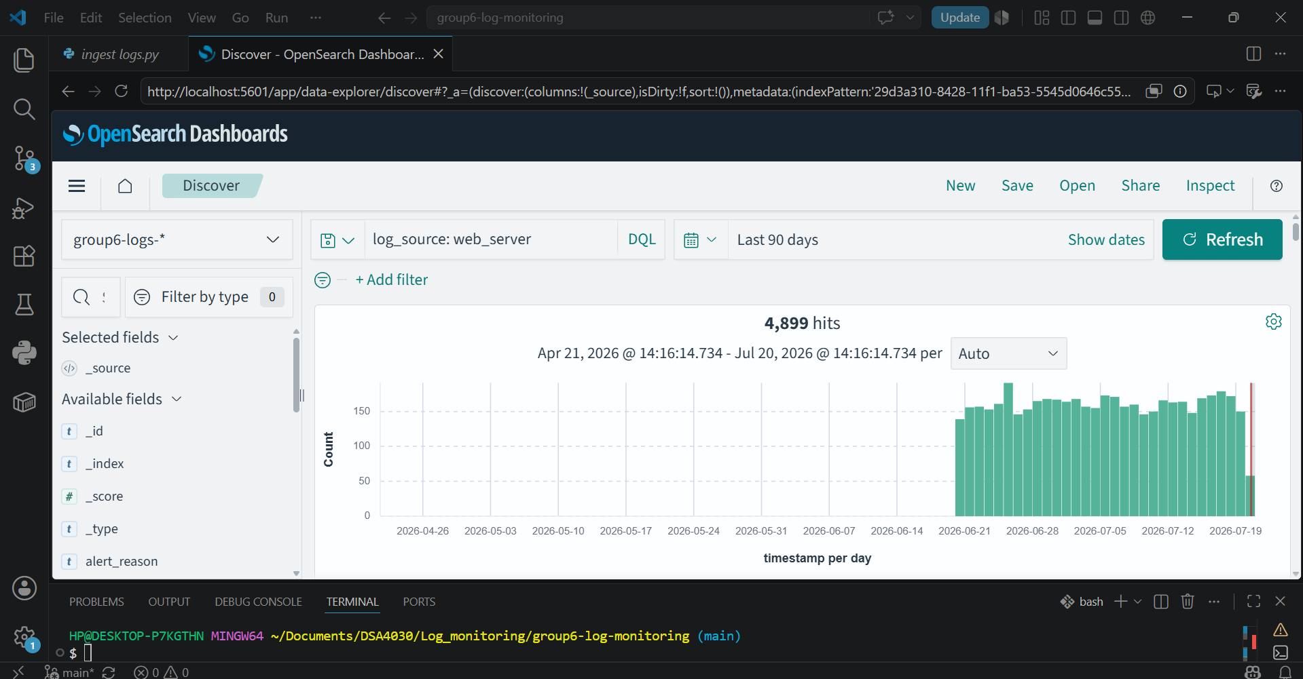
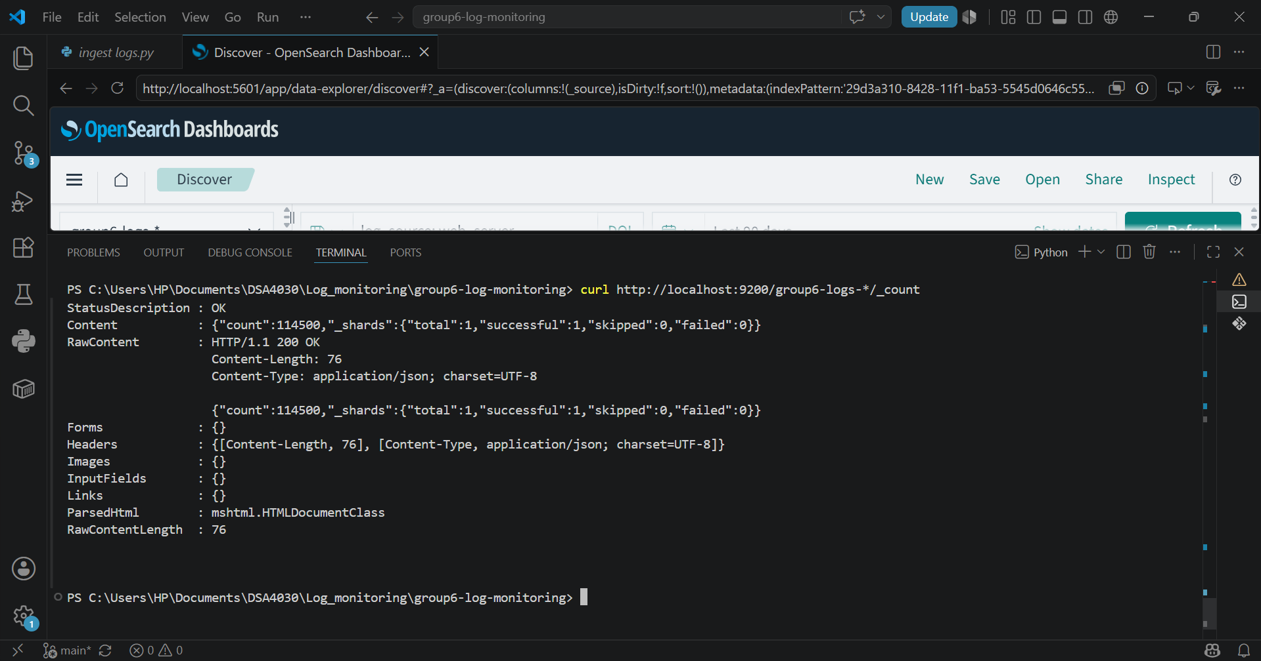
PART B
Dataset
100,000+
Custom dataset generated using Python to simulate realistic security events, meeting the assignment's minimum record requirement.
log records generated
SSH Login Events
Web Server Requests
Application Events
Python script generating the SSH, web, and application log dataset
Sample log entries — successful logins, failed logins, invalid passwords
Centralized Log Monitoring System | Group 6
Notes:
Instead of using a public dataset, we generated our own dataset using Python. This allowed us to simulate realistic security events while meeting the assignment requirement of at least 100,000 records.

Slide 5
ARCHITECTURE
System Architecture & Data Flow
Log Sources
SSH • Web Server • Application
Python Log Ingestion Script
Ingestion
scripts/ingest_logs.py
REST API — Port 9200
OpenSearch
Storage & Indexing
Log storage & indexing
OpenSearch Dashboards
Monitoring Layer
Visualization • Port 5601
Security Administrator
Monitoring & threat analysis
Centralized Log Monitoring System | Group 6
Notes:
The architecture starts with multiple log sources. The Python ingestion script reads and processes the logs before sending them to OpenSearch using its REST API. OpenSearch indexes the logs, and OpenSearch Dashboards displays them through visual dashboards.

Slide 6
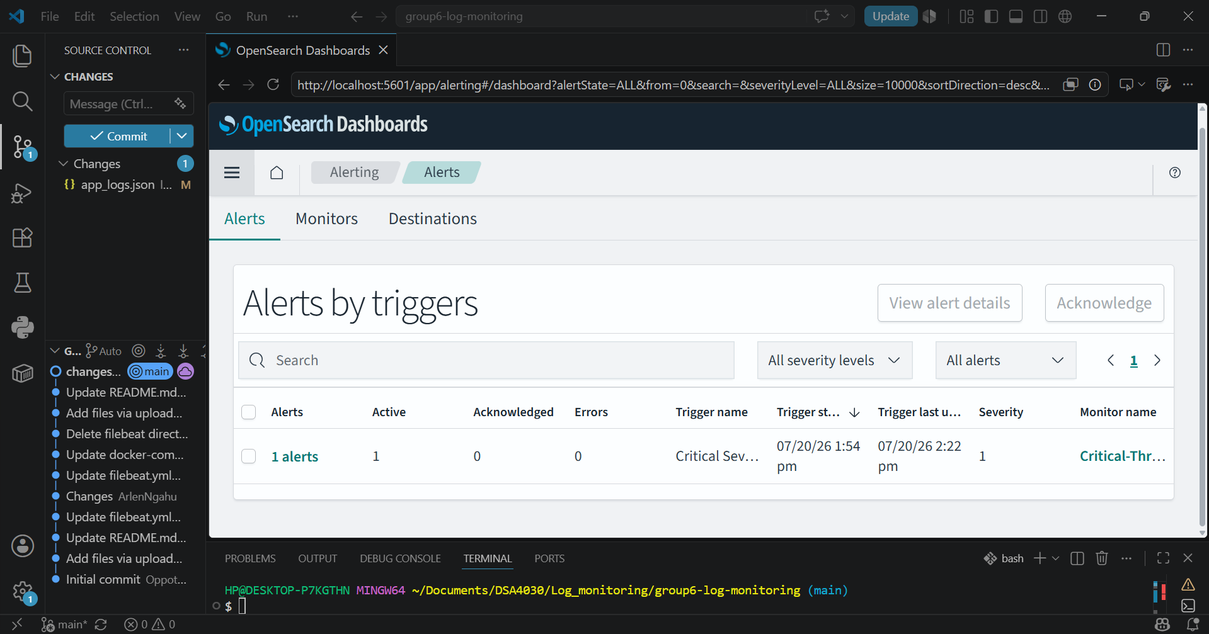
ARCHITECTURE
Log Ingestion in Action
The ingestion script reads records from each log source and pushes them into OpenSearch through its REST API on port 9200, where they are indexed for search and visualization.
Ingestion script indexing SSH, web, and application logs into OpenSearch
Centralized Log Monitoring System | Group 6
Notes:
Here you can see the ingestion script actively pushing SSH, web, and application logs into OpenSearch through the REST API on port 9200.

Slide 7
PART C
Security Controls
Implemented
Planned Improvements
✓
Centralized Logging
○
Authentication
✓
Log Indexing
○
Role-Based Access Control
○
HTTPS Encryption
✓
Dashboard Monitoring
○
Log Integrity Verification
✓
Suspicious Activity Detection
○
Automated Backups
Centralized Log Monitoring System | Group 6
Notes:
We successfully implemented centralized logging and monitoring. While authentication and encryption were not fully configured in this educational project, they were identified as important improvements for production deployment.

Slide 8
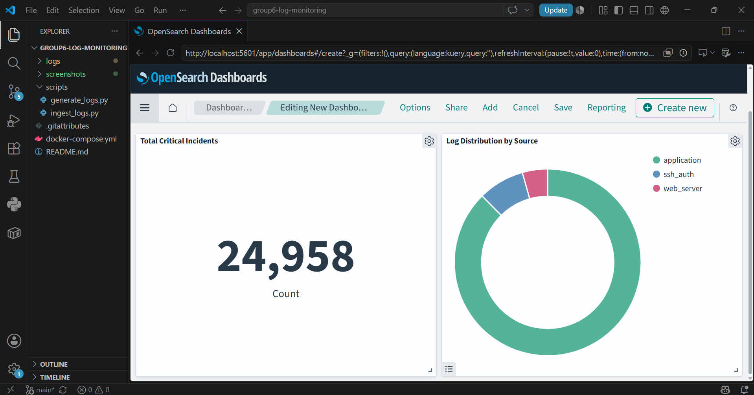
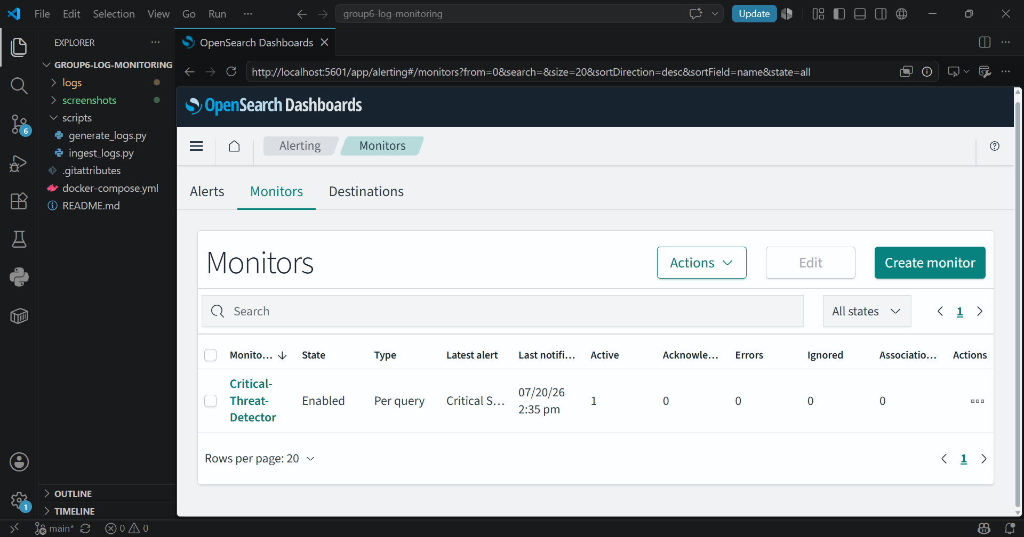
MONITORING
OpenSearch Dashboards
Log Visualization
Search & Filtering
Event Monitoring
Real-Time Analysis
Discover view — indexed logs searchable in real time
Visualization dashboard summarizing log activity
Centralized Log Monitoring System | Group 6
Notes:
The dashboard allows administrators to search, filter, and analyze logs. Here we see the Discover view with indexed logs, and a visualization dashboard summarizing overall activity.

Slide 9
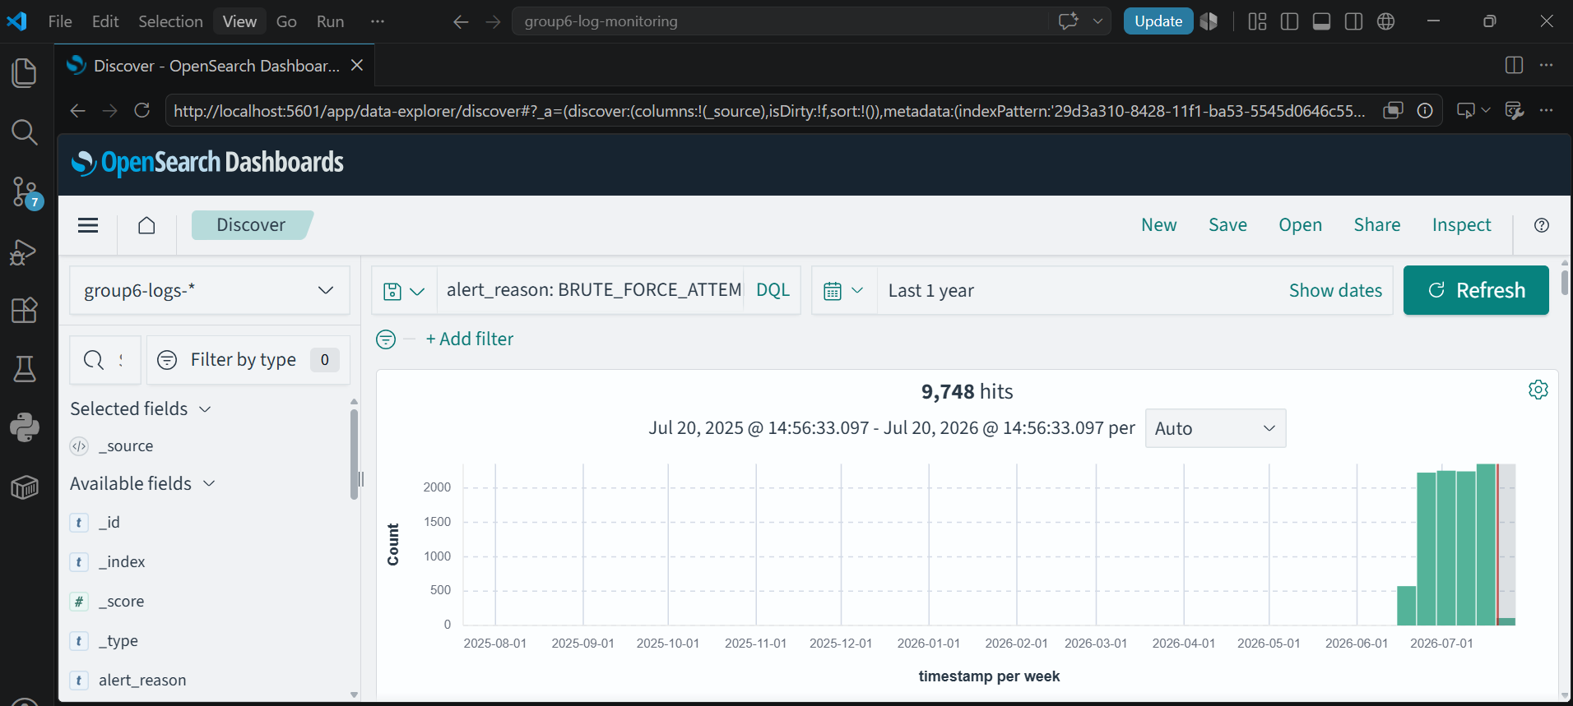
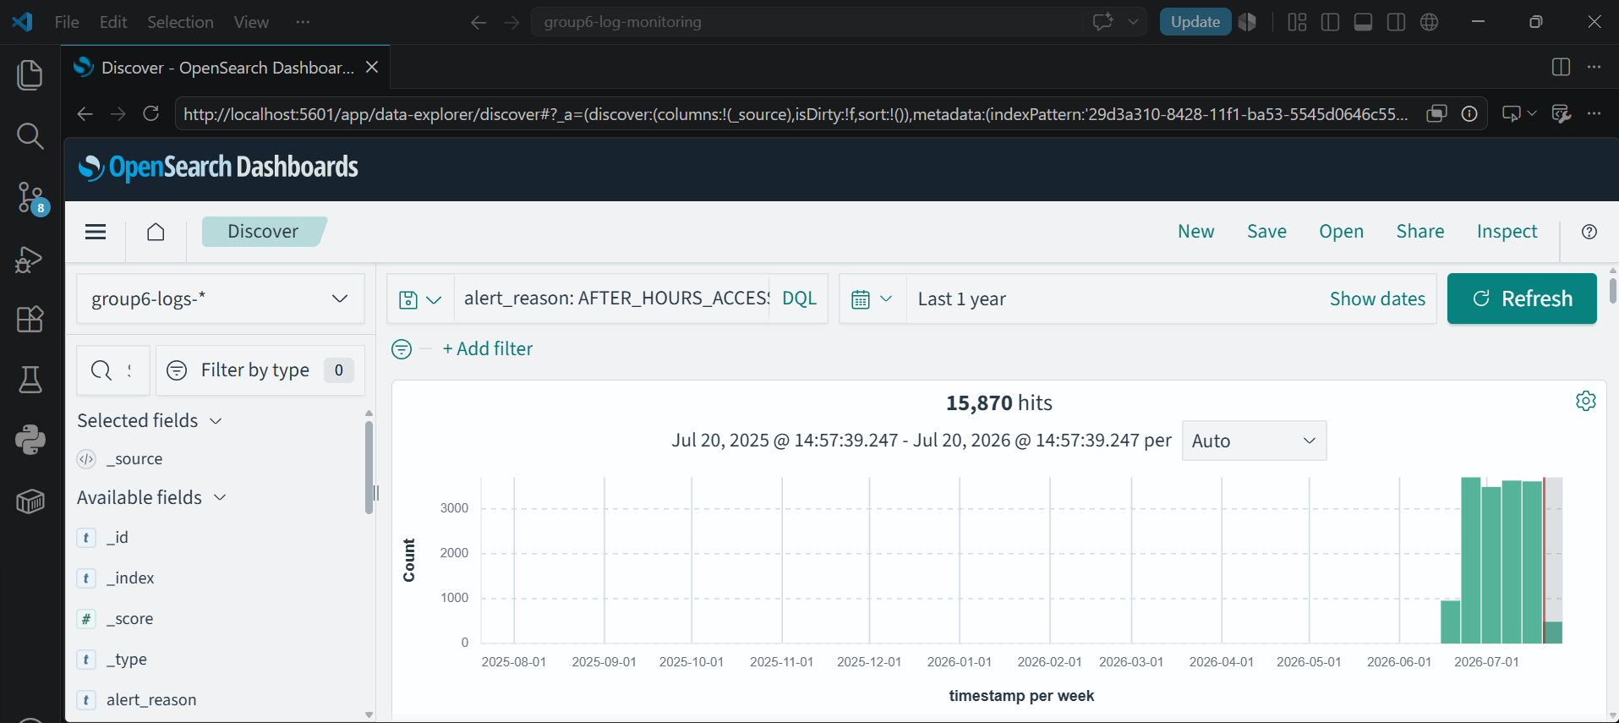
MONITORING
Attack Detection
Detected during testing: Failed SSH login attempts • Invalid login credentials • Suspicious authentication activity • Application errors
Real-time monitoring dashboard
Failed login attempts surfaced via search & filtering
Centralized Log Monitoring System | Group 6
Notes:
During testing, we were able to identify failed login attempts and suspicious authentication activity, demonstrating the effectiveness of centralized monitoring in near real time.

Slide 10


PART D
Security Testing
Tests Performed
Log Collection
Passed
Log Ingestion
Passed
Dashboard Visualization
Passed
Evidence — test verification in OpenSearch Dashboards
Failed Login Detection
Passed
Search Functionality
Passed
OpenSearch Connectivity
Passed
Evidence — indexed logs & dashboard output
Centralized Log Monitoring System | Group 6
Notes:
We conducted several security tests to verify that logs were collected correctly, indexed into OpenSearch, and displayed on the dashboard. We also confirmed that failed login attempts could be detected successfully.

Slide 11
PART E
Vulnerabilities & Recommendations
Vulnerabilities & Risks
Recommendations
!
Authentication disabled
✓
Enable authentication
!
Security plugin disabled
✓
Configure HTTPS
!
Open network ports
✓
Restrict exposed ports
!
No HTTPS encryption
✓
Encrypt stored logs
!
No Role-Based Access Control
✓
Enable Role-Based Access Control
Risks: Unauthorized access • Data leakage • Log tampering • Service disruption
✓
Perform regular vulnerability assessments
Centralized Log Monitoring System | Group 6
Notes:
Our security assessment showed that while the system functions correctly, several security improvements are necessary before production deployment. These include enabling authentication, encryption, and access controls.

Slide 12
CONCLUSION
Executive Summary
✓
Built a centralized log monitoring system collecting from 3 sources
Conclusion
✓
Generated over 100,000 log records
Centralized logging improves security monitoring by giving administrators a single platform to collect, analyze, and visualize system logs.
The system meets the assignment's functional requirements; adding authentication, encryption, and role-based access control would prepare it for production use.
✓
Stored and indexed logs using OpenSearch
✓
Built dashboards for live monitoring
✓
Demonstrated attack detection via failed-login monitoring
✓
Identified vulnerabilities and proposed security improvements
Notes:
Our project successfully met the assignment objectives by implementing centralized log collection, visualization, and attack detection. The recommendations we proposed would further strengthen the system's security and reliability in a real-world environment. Thank you — we're happy to take any questions.

